Slide 1
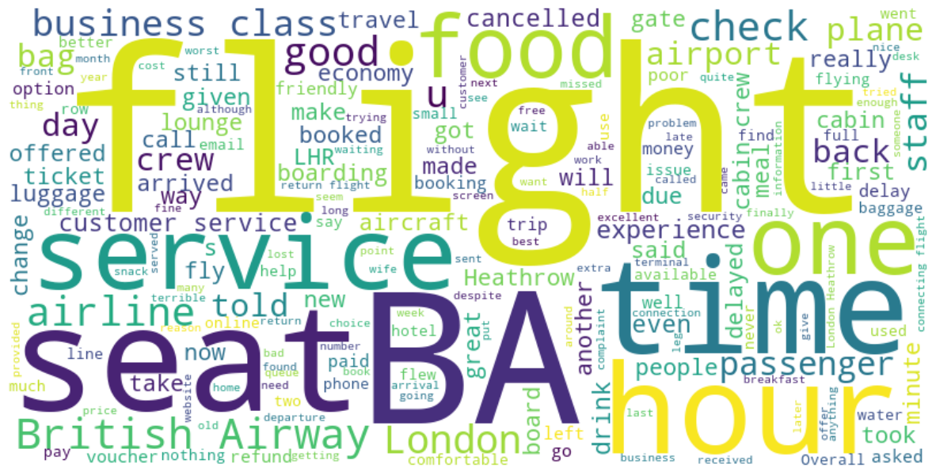
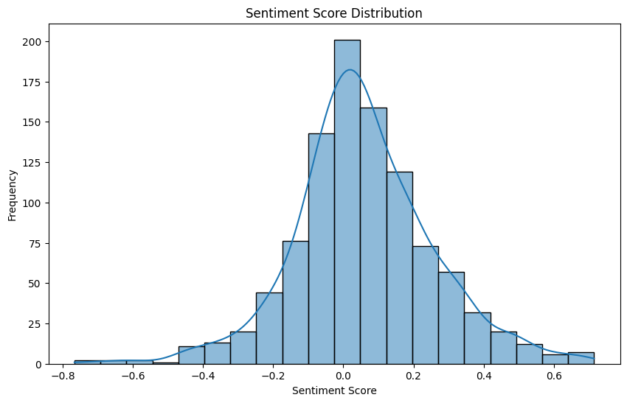
Title: Insights From British Airways Reviews Analysis
Word cloud
Total Reviews Analyzed: 1,000
Average Sentiment Score: 0.35 (Neutral)
Most Salient Terms:
flight
ba
service
Key Insights:
Out of 1000 reviews, 546 were positive, 437 were negative and 17 were neutral. This means the majority of reviews were polarised as either positive or negative.
Sentiment Scale: -1 (Negative), 0 (Neutral), 1 (Positive)

